Slide 2
Registration
Time can be reduced, if there is que We can introduce self kiosk setup

Slide 3
Traige level
Doctors seeing patient Nurses level of experience! In a shift is there seniors , juniors , makes difference, in expediting
Resolving , directing the path. Example metal detector, to sovle.
He helped scanning.

Slide 4
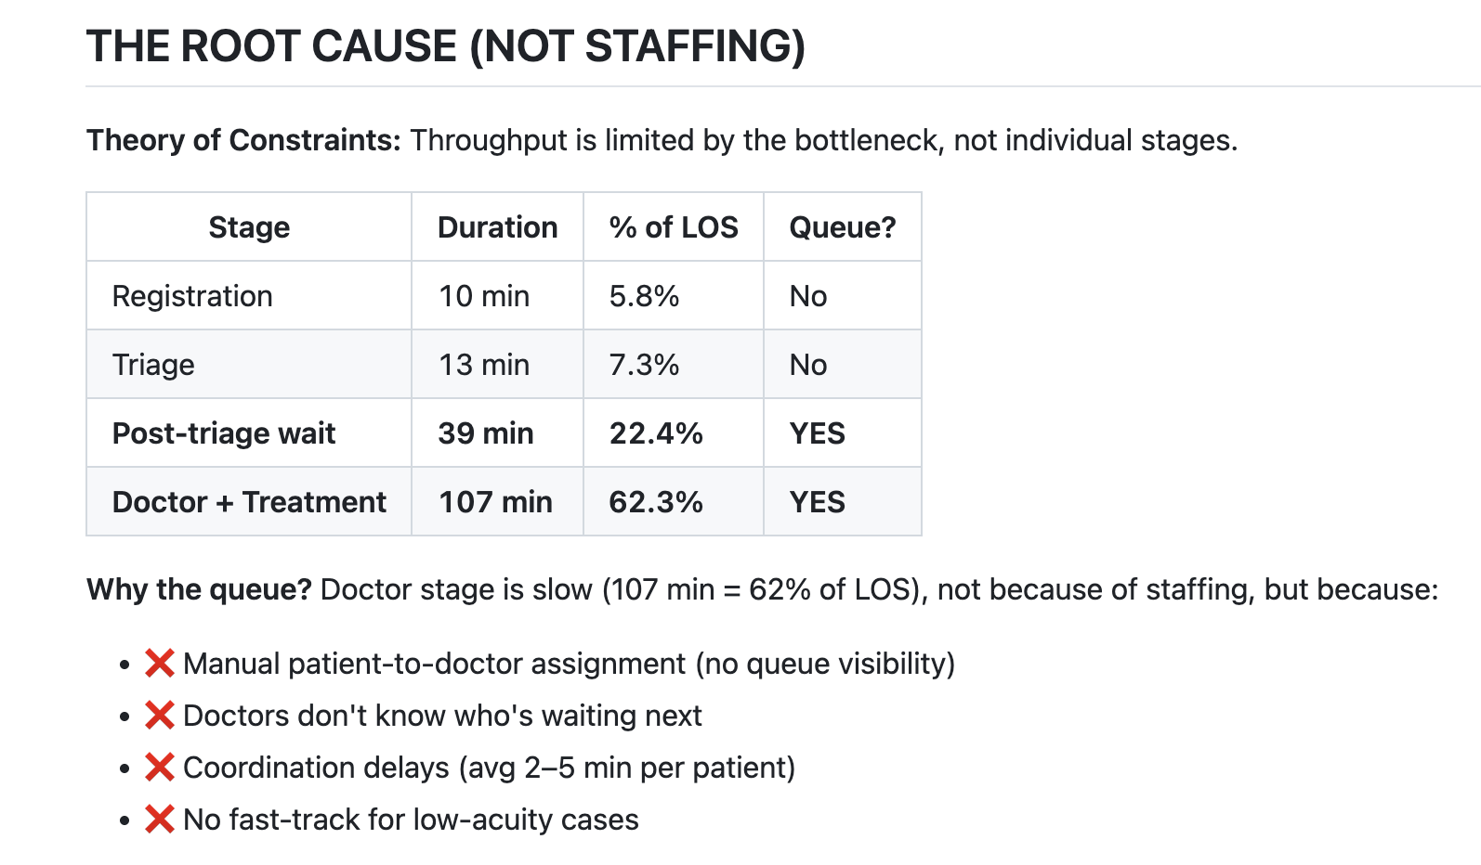

Slide 5
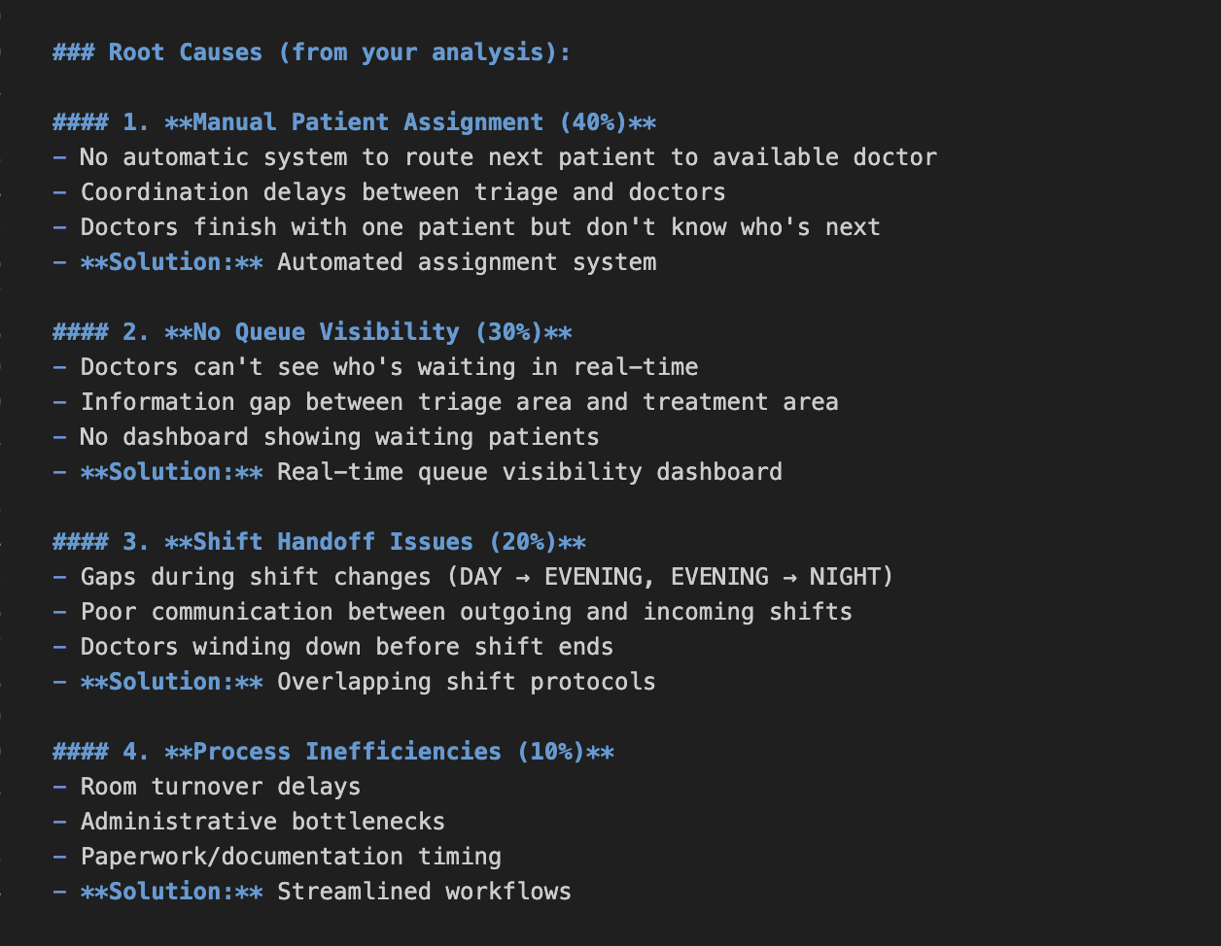

Slide 6
Before:
Patients wait 39 minutes after triage
Doctor utilization: 50%
2,179 bottleneck events per quarter
Patients waiting time, staff utilization
After:
Patients wait 12-15 minutes
Doctor utilization: 75%
<500 bottleneck events per quarter

Slide 7
Doctors work sequentially ?
At 2025-03-07 12:23:00, there are:
Only 6 clinicians on duty
But 38 patients marked as "active" (between doctor seen and exit)
This makes no sense! 38 patients can't be with 6 doctors simultaneously.
A doctor sees Patient A at 12:00
While Patient A is still in the system (getting tests, waiting for discharge, etc.), the doctor moves on to see Patient B at 12:15
Then Patient C at 12:30, and so on
So at 12:30, all three patients (A, B, C) might still be "active" in the system, even though the doctor has already moved on.
Hence, Doctors work in parallel , they're not seeing patients 1:1 sequentially

Slide 8
Doctors has the call !
They need information about what is happening in the after triage
Who is waiting ? How many are waiting?
Why need this because, they need to know what is waiting whom to call . Based on the bed resources, specialist etc.
More power to the doctor.
Patient Wait Time after triage = f(Severity, Test Turnaround, Room Availability, Staff Workload)
Wait Time = f(Severity, Test Turnaround, Room Availability, Staff Workload)

Slide 9
The issue isn't doctor availability per se, but distribution and utilization. Night shift does more with less - suggesting day/evening doctors may be underutilized despite higher numbers.

Slide 10
Test Turnaround (Lab/Imaging Speed)
How it affects doctor seen time:
Directly: If doctor is waiting for test results before seeing patient again
Indirectly: Slow tests → patients stay longer → beds fill up → doctor gets backed up
What to measure:
python
# Time from test order to result test_turnaround = test_result_time - test_order_time # How this delays doctor workflow: # - Doctor orders X-ray at 10:00 # - X-ray takes 90 min (slow!) # - Doctor can't finalize treatment until 11:30 # - Meanwhile, doctor sees other patients, gets backed up
Key insight:
Slow tests don't directly delay initial "doctor seen"
But they increase doctor workload (managing more patients simultaneously)
This creates a ripple effect → doctor gets overwhelmed → wait times increase for NEW patients

Slide 11
Only thing
only strong correlation between avg wait time is the severity level.

Slide 12
What determines time in the doctor seen area
Factor | Data Available? | How to Detect?
Severity | Yes - Triage Level 1-4 | Can prioritize: Level 1,2 > Level 3,4 to Fast Track
Test Turnaround | No - Not in data | We can't know if patient is waiting for lab results
Room Availability | Partial – We have bed details not lab details. | We don't know bed/room status at each moment
Staff Workload | Partial - Doctors On Duty, Nurses On Duty | Can estimate from concurrent patient count

Slide 13
Our Solution - Hybrid Approach:
Phase 1-4: Deterministic Analysis ← Start here
Use clear rules with documented assumptions
Calculate bed occupancy
Find specific bottleneck instances
Categorize root causes
Phase 5: Address Randomness
If unexplained variance is high (>30%)
Recommend: Process Mining, Queuing Simulation, or ML
Don't over-promise what this analysis can show

Slide 14
Our Solution - Hybrid Approach:
Phase 1-4: Deterministic Analysis ← Start here
Use clear rules with documented assumptions
Calculate bed occupancy
Find specific bottleneck instances
Categorize root causes
Phase 5: Address Randomness
If unexplained variance is high (>30%)
Recommend: Process Mining, Queuing Simulation, or ML
Don't over-promise what this analysis can show
Our Solution - Hybrid Approach:
Phase 1-4: Deterministic Analysis ← Start here
Use clear rules with documented assumptions
Calculate bed occupancy
Find specific bottleneck instances
Categorize root causes
Phase 5: Address Randomness
If unexplained variance is high (>30%)
Recommend: Process Mining, Queuing Simulation, or ML
Don't over-promise what this analysis can show

Slide 15
Fast Track beds
Fast track beds closes at 11pm . Due to volume. And opens in th e day shift at 7 am.
However, the there is clear 5-7 am surge in hence these beds should be opened by 4 am ready . And keep them ready
L3 and L4 are higher, and hence utilizing the max capcity of 10 is must. However closing at night makes sense.
Visualise with the volume and area chart .and simulate

Slide 16
Sample type example
On March 7, 2025, 14:40-14:50 (DAY shift):
Doctor A just finished Patient X (exit 14:40 + 10-min buffer = available 14:50)
How many were inside the doctor seen ?
Patient Y (Severity 2) has been waiting since 14:05 (45 minutes!)
Patient Z (Severity 3) has been waiting since 14:20 (30 minutes)
Doctor A was available at 14:50 but didn't see Patient Y until 15:15
Wasted: 25 minutes of patient wait (coordination failure, not test delay)

Slide 17
SYSTEM Ineficcinye
Doctor not knowing if patient is waiting after triage
Reason for visit is expected to collect at the registration.
UI can be improved, Text box to drop down or radio button
Real time dasboards to keep up the transparency connected to displayed.outside triage, inside based on the data collected at the registration.( caveat: excptions )
Calling out patients , rodrigr comment.

Slide 18
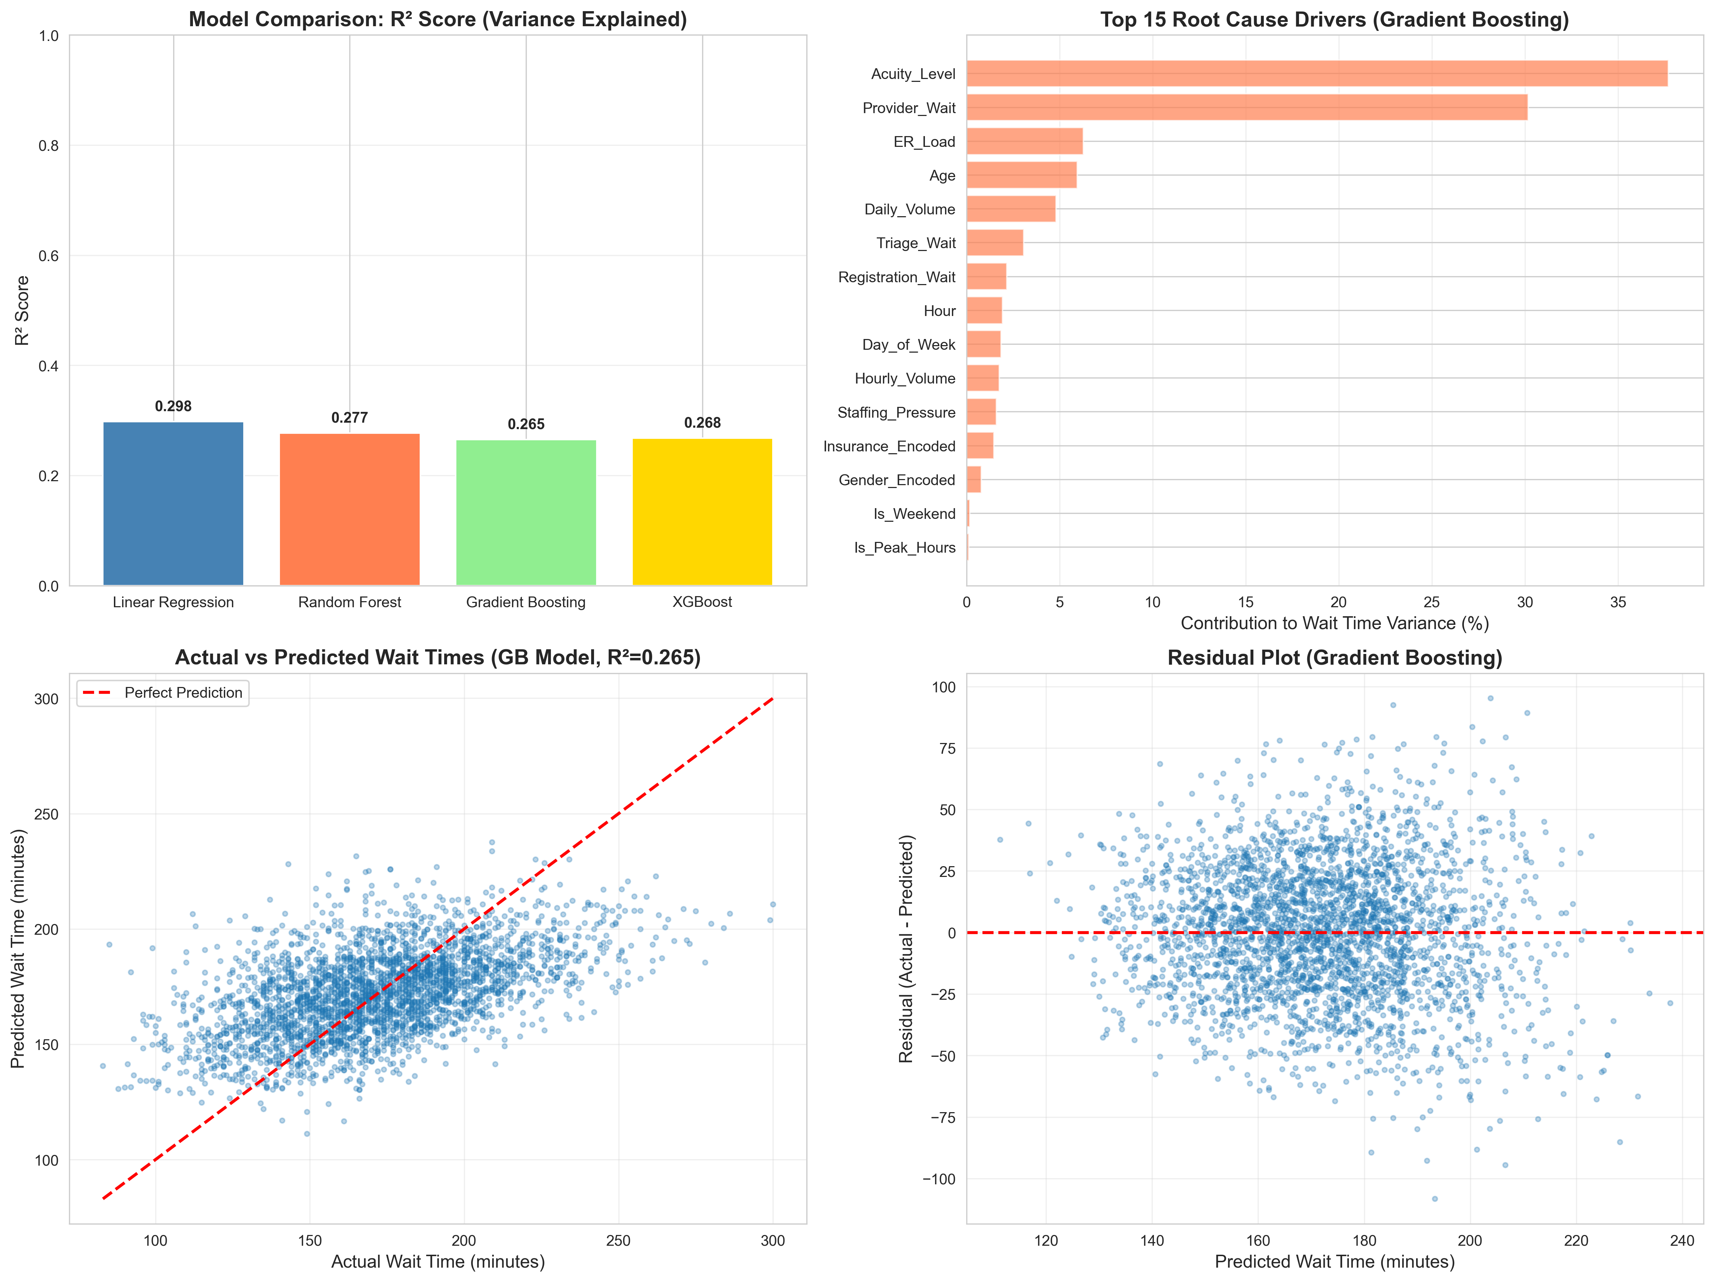

Slide 19
- Average time: Arrival → Doctor Seen
- Number of patients in "waiting to be seen" status
- Patient-to-doctor ratio during peak hours

Slide 20
Why monitoring? Why Intelligent Queue Dispatch
There are cases where patients from doctor seen area exited. But there were people waiting at triage . Who could have been called.
This shows that the visibility to after triage area for the actors in the doctor seen area are limited / restricted.
Why it nudges the behavior .

Slide 21
What is the implementation budget?

Slide 22
How to Recover ?

Slide 23
Cost Calculation

Slide 24
Nudge Pshycology

Slide 25
We found 69 definitive idle cases where the doctor had zero other patients yet patients waited.

Slide 26
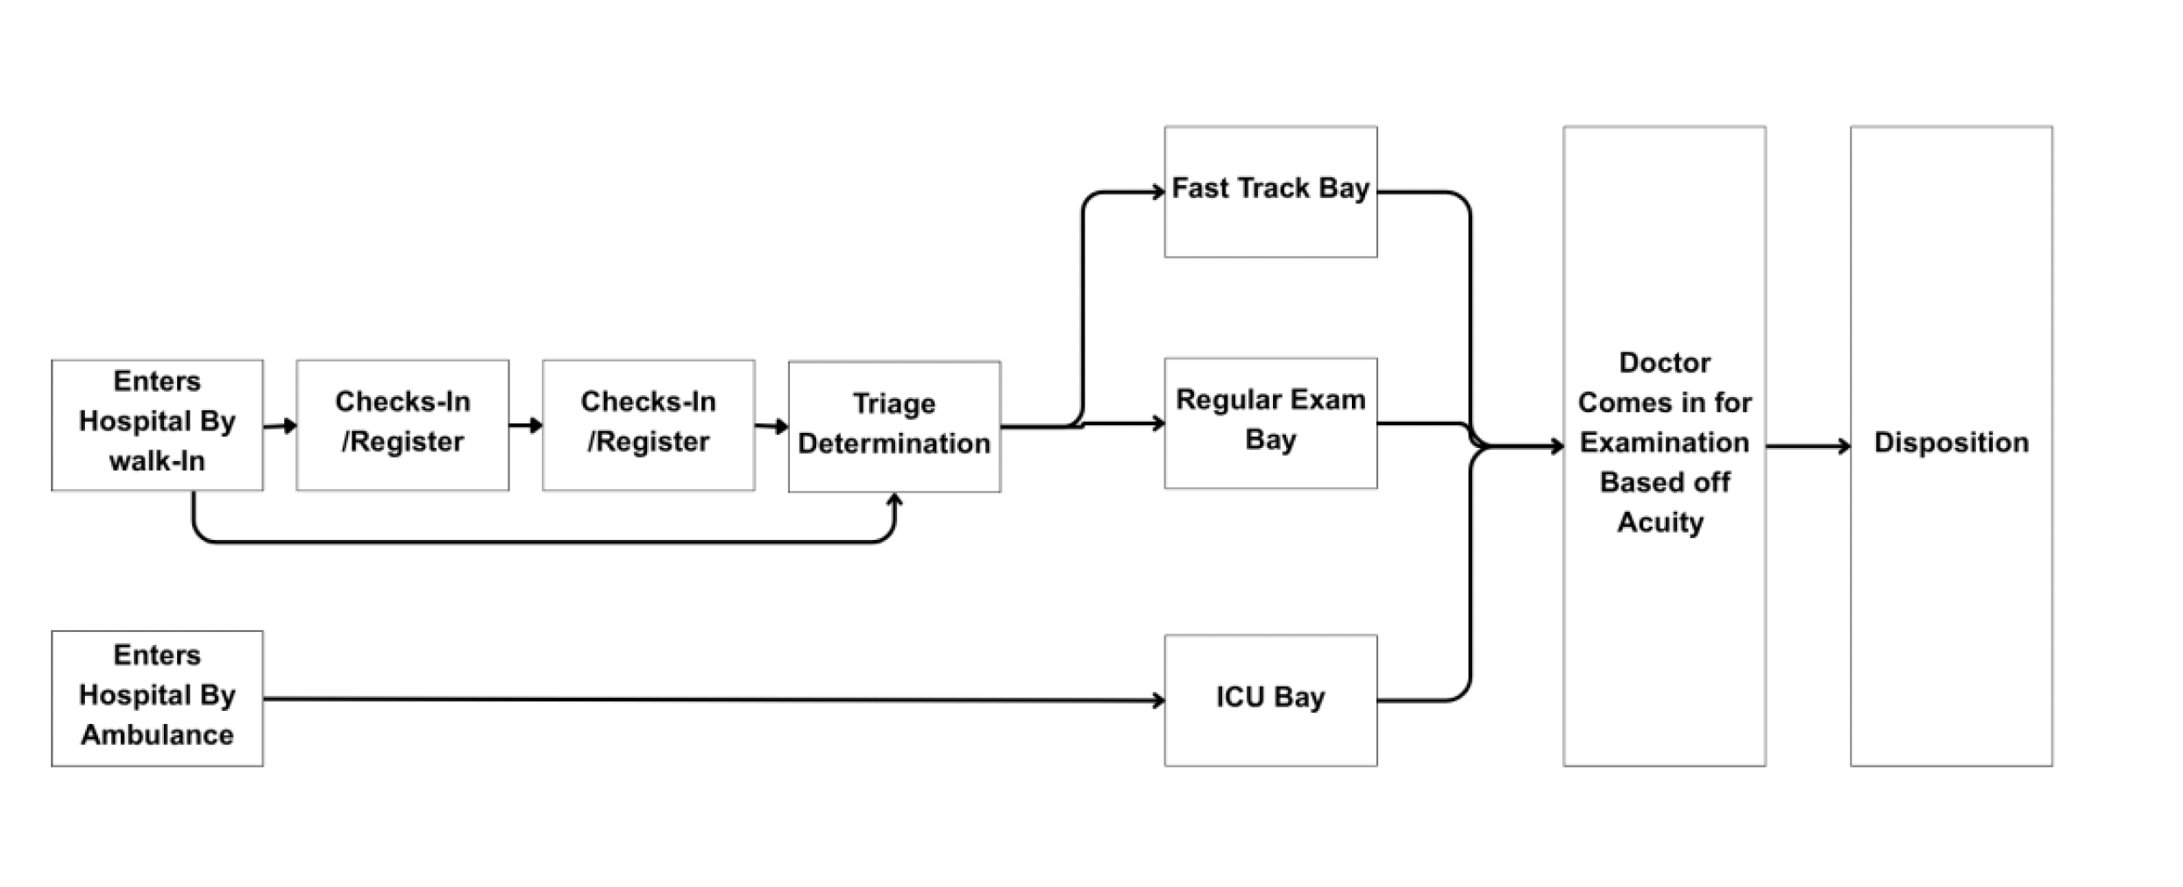
DETAILED FLOW VIEW

Slide 27
SIMPLIFIED SYSTEM VIEW
IN
ER SYSTEM
OUT

Slide 28
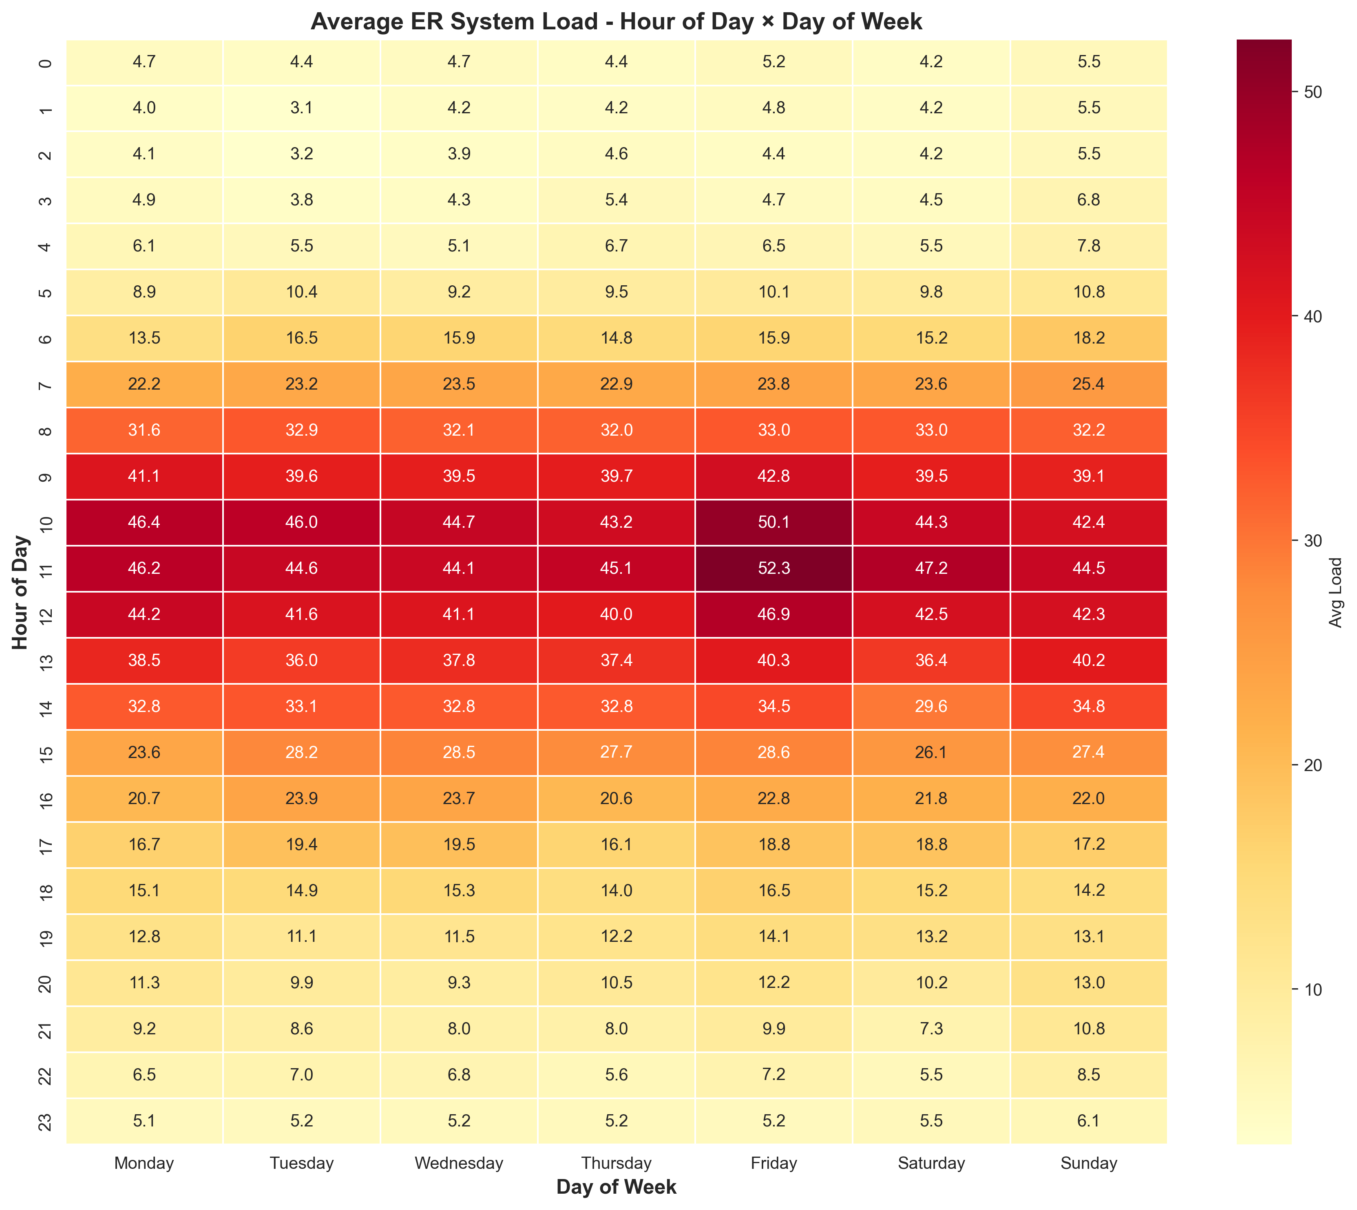
Notes:
52 Patients = AVERAGE/TYPICAL PEAK (shown in the Heatmap)

Slide 29
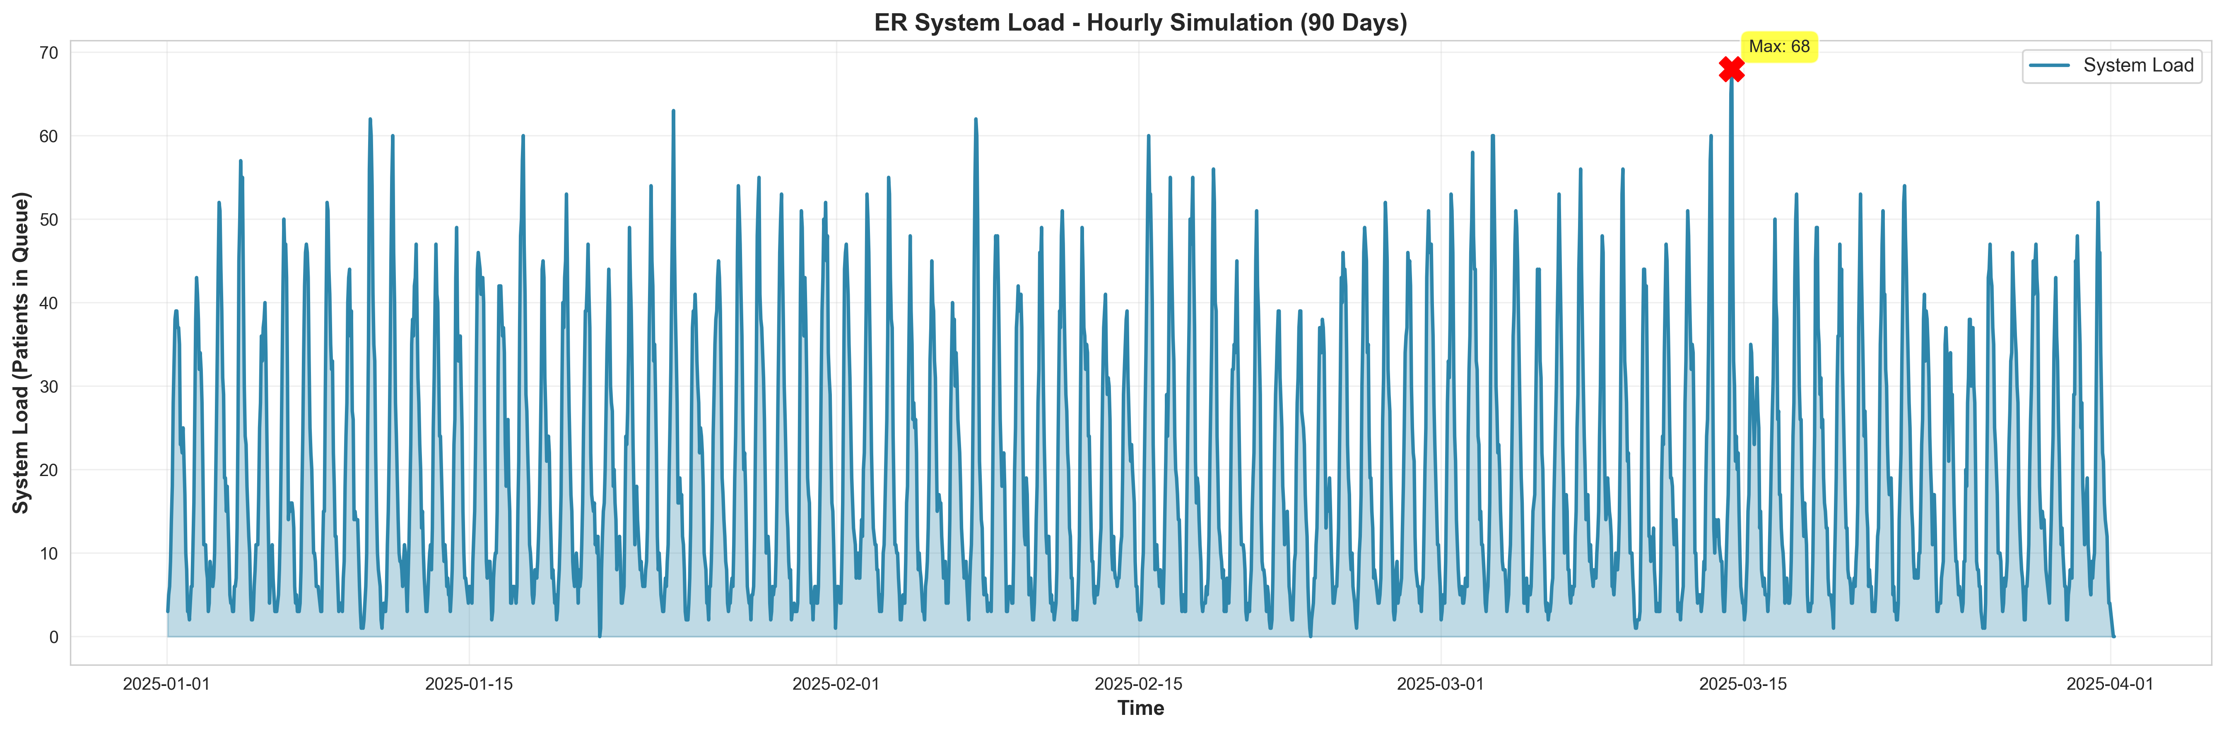
*Friday, March 14, 2025, at 11:00 AM
Notes:
68 Patients = ACTUAL PEAK (March 14, 2025 at 11:00 AM)

Slide 30
